Slide 1

SILENCE CAN BE ENGGINERED
The DSP Inside Your ANC Earphones

Slide 2
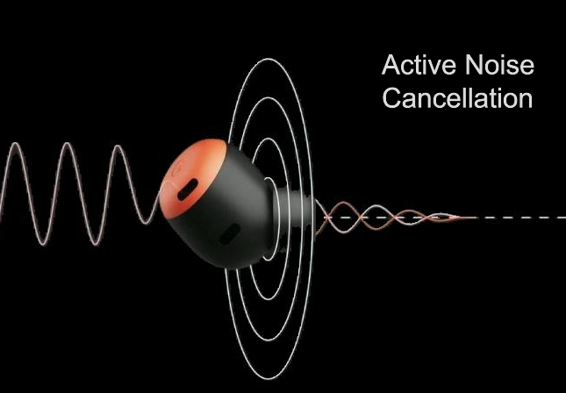
What is anc??
Active Noise Cancellation (ANC) is the technology .
Used in headphones and earbuds to minimize unwanted ambient sound .

Slide 3

TH
This is how it feels after turning on ANC .

Slide 4
Ever wonder how anc works ??
Well, it works on principle of superposition But how we are generating anti-noise in headphones.
IT MEANS THERE IS SOMETHING MORE

Slide 5
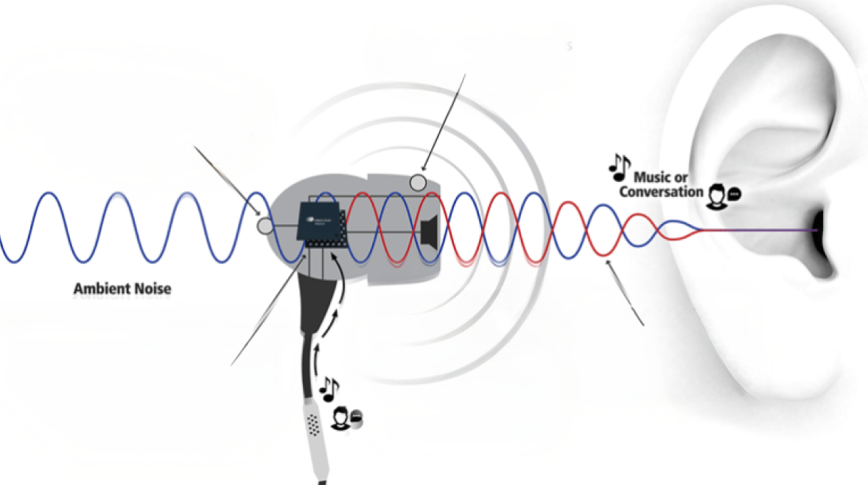
Error microphone that monitors what we hear
Microphone which monitors ambient sound.
Ambient sound
Anti- noise signal cancelling ambient noise signal providing clean music to listener
Something which mentioned earlier is this small hardware

Slide 6
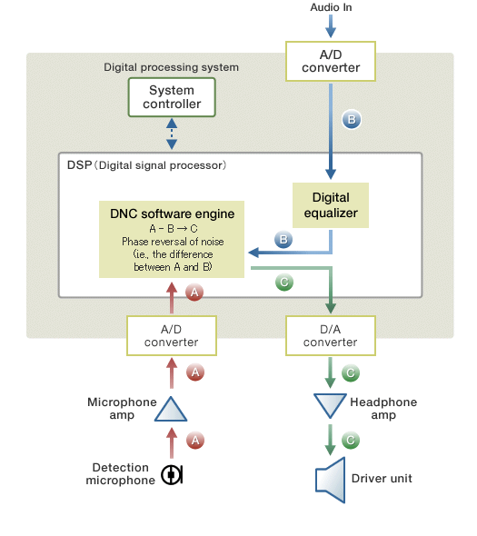
How does this hardware work ??
Digital Signal Processor (DSP)
B - A --- c
I know you do not have idea about DSP

Slide 7
What is Digital signal Processor (DSP) ?
It takes digitized real-world signals such as audio, voice, or video and mathematically manipulates them in real-time at high speeds.
Here It contains :-
Digital equalizer
Direct Numerical Control(DNC)
signal
signal

Slide 8

What is digital equalizer
a software-based tool or digital signal processing (DSP) algorithm used to adjust the volume of specific frequency ranges—such as bass, mids, or treble—within an audio signal.

Slide 9
Use of DNC ( direct numerical COntrol)
Our algorithm of ANC ( means making Anti-signal ) is present here
Real-time File Transfer
Enables remote request here like turn on ANC or turn off ANC

Slide 10
How does this hardware work ??
Digital Signal Processor (DSP)
Signal B is our main music .
Signal A is our ambient-signal
Phase reversal of signal A is –A
What should be the output sound = B – A = C
B - A --- c

Slide 11
What did we cover in this session??
What is ANC??
How does the ANC works ?
What is DSP
Use of DNC

Slide 12
THANK YOU

